Slide 1

Amit Sharma (011090820)
Mayank Tanwar (011435320)
Navneet jain (011419291)
Prateek Sharma (011475620)

Slide 2

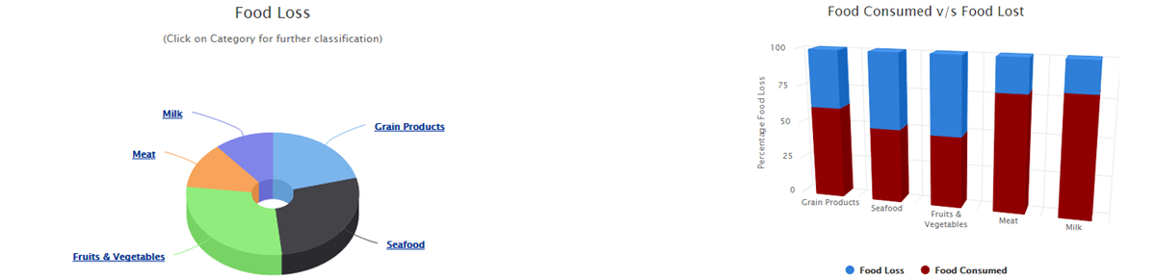
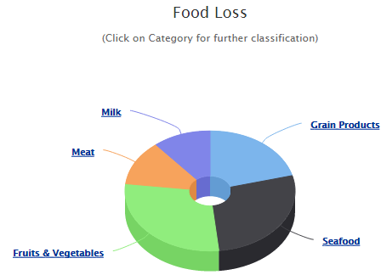
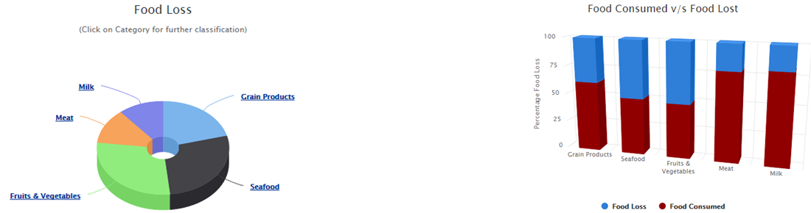
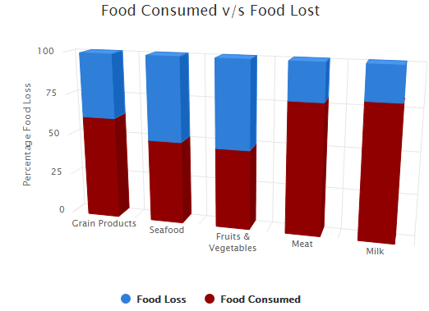
Problem statement
40 percent of food in the United States alone goes uneaten causing loss of $165 billions each year.
Reducing food losses by just 15 percent can feed more than 25 million Americans every year.
Businesses should streamline their own operations, to reduce food losses and save money.
This is where FoodCoin fits in.
We provide solutions for restaurant businesses to optimize their operations.

Slide 3
solution statement
Before Operations:
1> Prediction of Number of guests per day.
Get the prediction of the number of customers you can expect on any given day, based on the customer behavior extracted from customer analytics. This will facilitate you in planning your day work ahead.
You can count on your expected daily customer traffic which we provide you, which is rendered to you by running our analytics on the pattern of customer visits in past.
2> Prediction of the quantity of food.
Prediction of the quantity of food materials that will be required throughout the day is rendered to you in advance, before your business day starts.
This makes it much simpler to work out inventory maintenance in advance without understocking and overstocking.

Slide 4
solution statement (Cont..)
After Operations:
1> Sentiment Analysis:
We process the user reviews and we render the ready to use information based on the analytics on the user reviews, which have crucial information on customer expectations.
Through the Sentiment Analysis of the user reviews, it is very easy to have a check on what is working and what is not working. This facilitates in making the customers happy.
2> Push Notifications:
We send the real time notifications to the subscribers who can benefit from discounts on the excess food in pantry, which otherwise has the potential of going to waste.
Through SMS on mobile phones as well as through native notifications inside the application, we communicate with our subscribers, who in turn help restaurants in reducing food wastage.

Slide 5
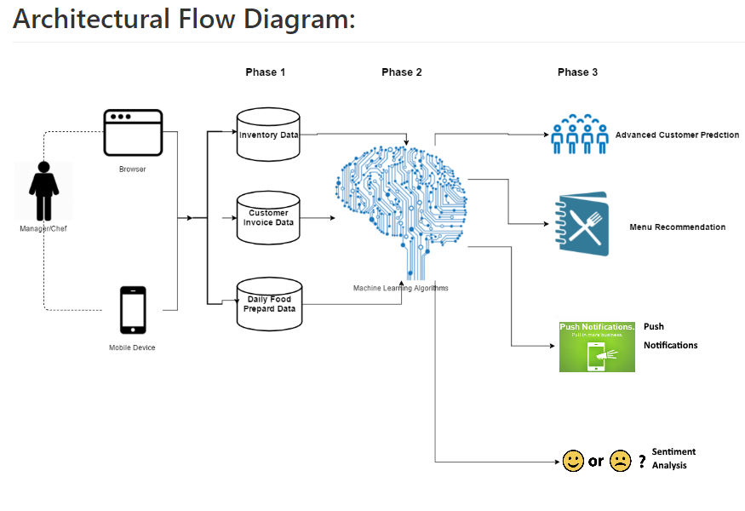
Architectural flow diagram:

Slide 6
Business model
Our business model is simple.
1> We are Software as a Service (SaaS) vendor.
2> We provide services to restaurants which enable them to reduce their food wastage, know
more about their customer sentiments, know their customer traffic and food requirement.
3> Our service is free to join and test for first 3 months.
4> After 3 months, independent restaurants still can continue to use it for free.
How ever, for restaurant chains, they have to pay a nominal fee if their chain size is more than
5 in number.
5> We will show recommendations for inventory procurements. We will charge vendors who
will be on recommendation list on every transaction made through us . Restaurants can use
this feature for free.
Recommendations will not be like advertisements. They will have a dedicated space on our app
and will be available for voluntary participation.

Slide 7
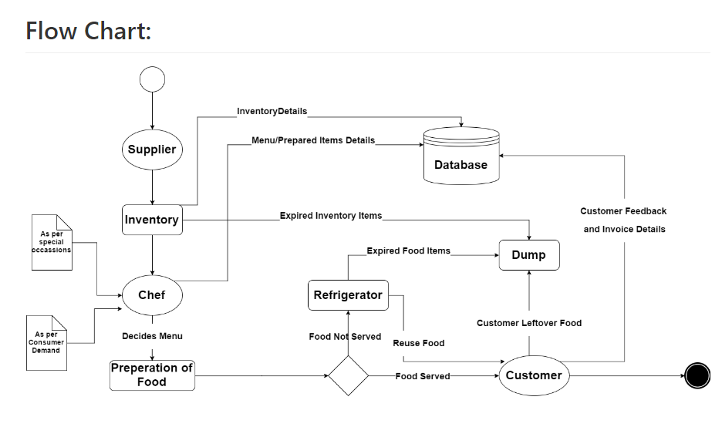
Flow chart

Slide 8
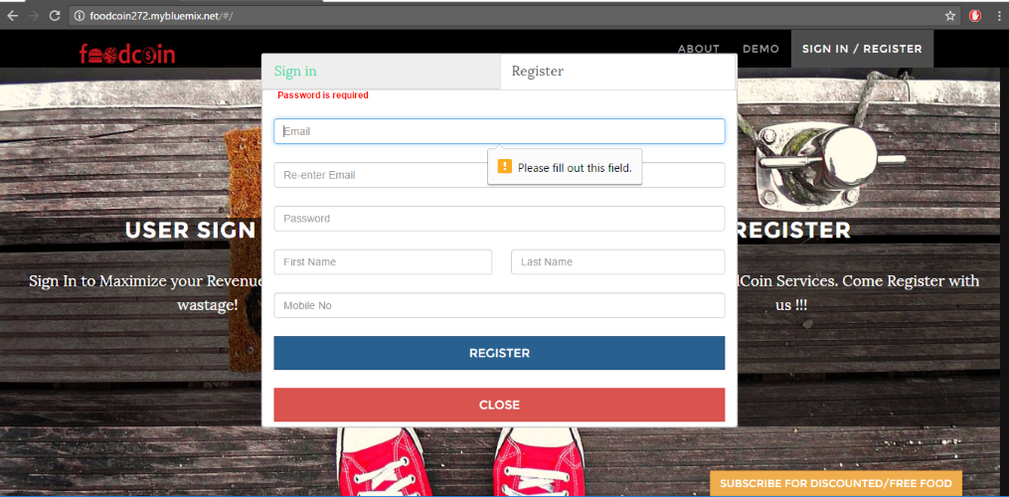
Security Features:
1. Password Required

Slide 9
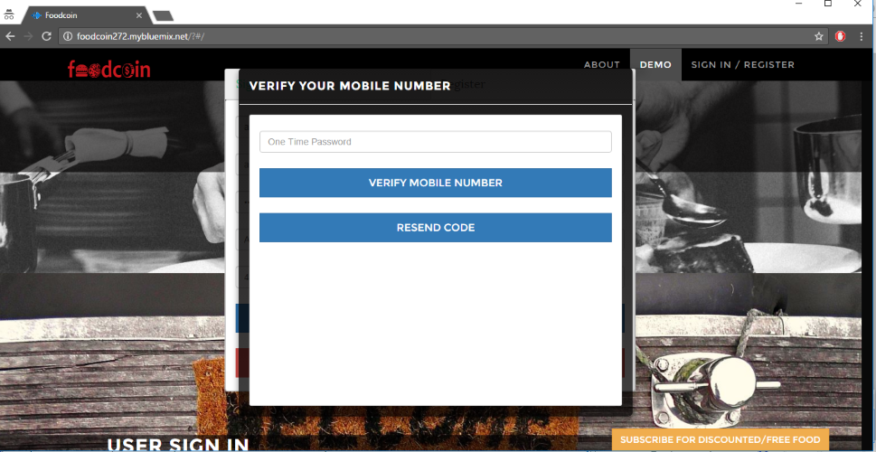
Security Features:
2. OTP Required for Registration and login

Slide 10
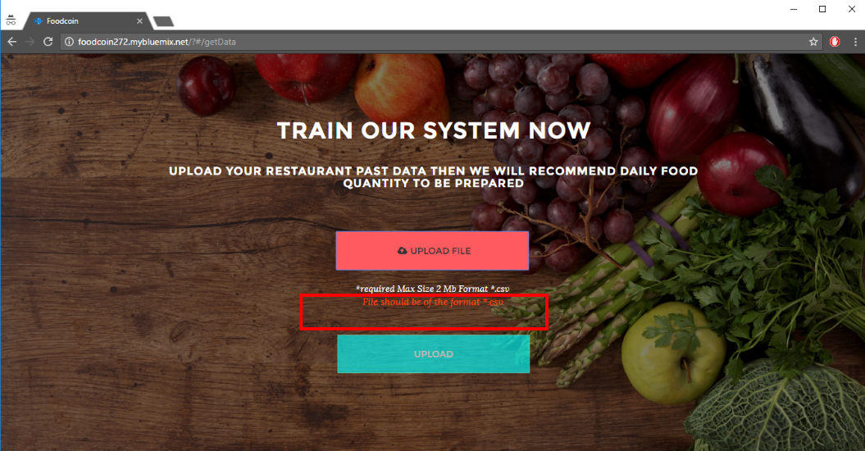
Security Features:
3. Only Correct file formats accepted

Slide 11
Thank You !
Questions?

